Slide 1
Inference PCA
The Survey of autobiographical memory (SAM) Dataset
Sruti Jain
2017.10.2

Slide 2
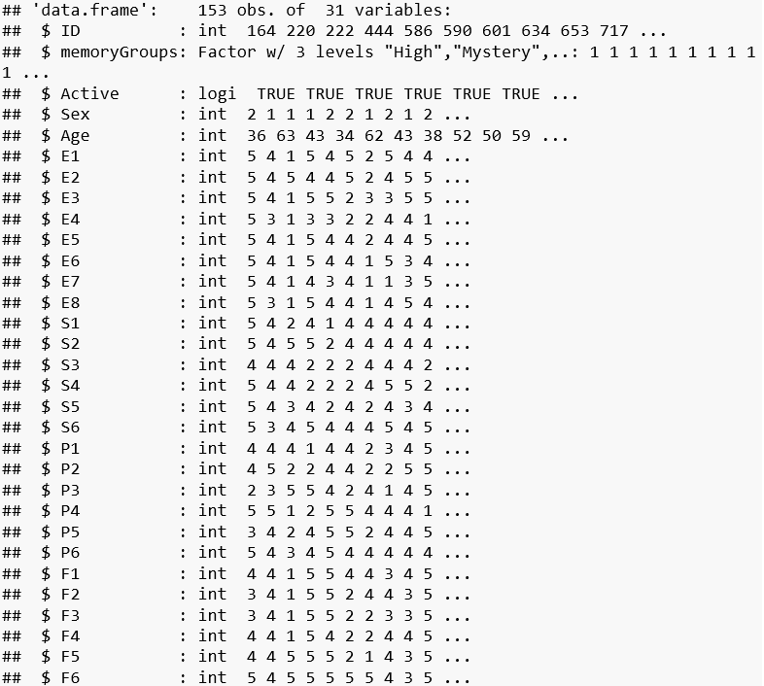
Introduction
Data: The survey of autobiographical memory (SAM) Dataset
Rows: Total participants of 144 after excluding the mystery group.
Columns: ID, memoryGroups, Active, Sex, Age, 26 questionnaire variables
Research Question
How these questions are related to memory – Episodic, Semantic, Spatial, Future?

Slide 3
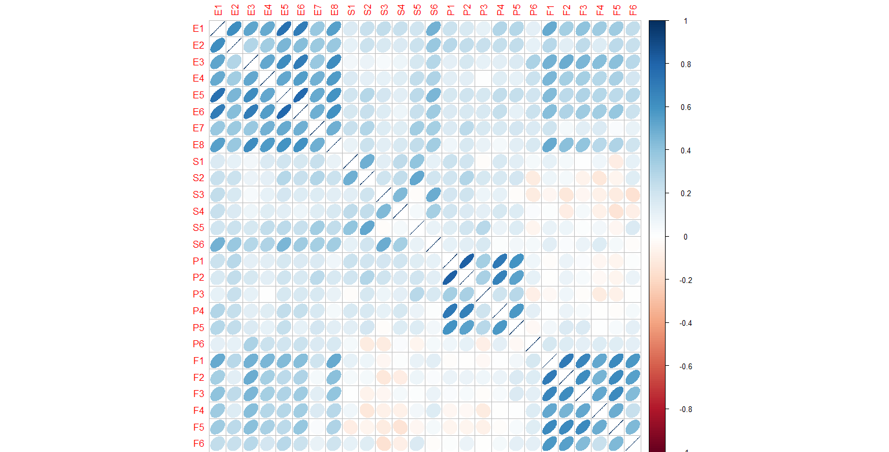
Results (1/5): Correlation plot

Slide 4
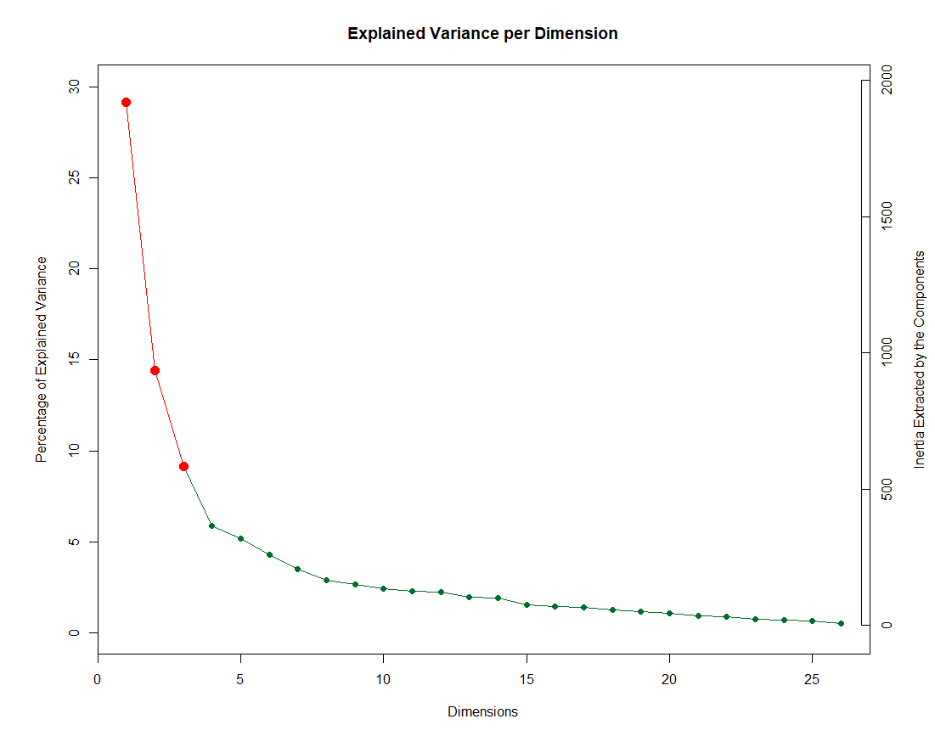
Results (2/5): Scree plot

Slide 5
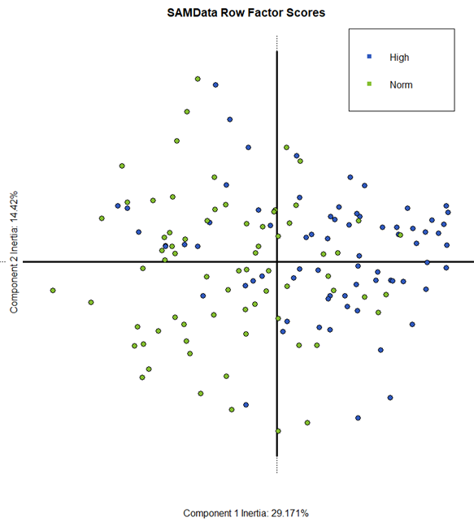
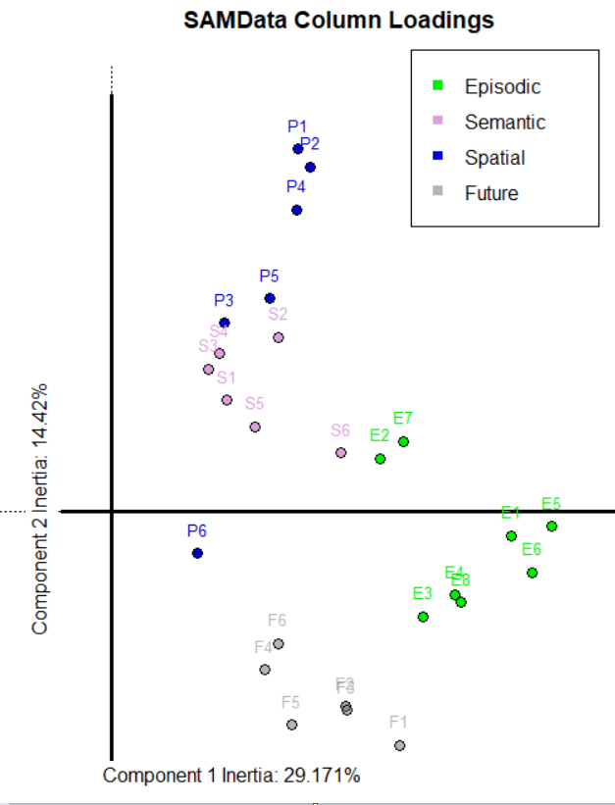
Results (3/5): Factor scores and loadings

Slide 6
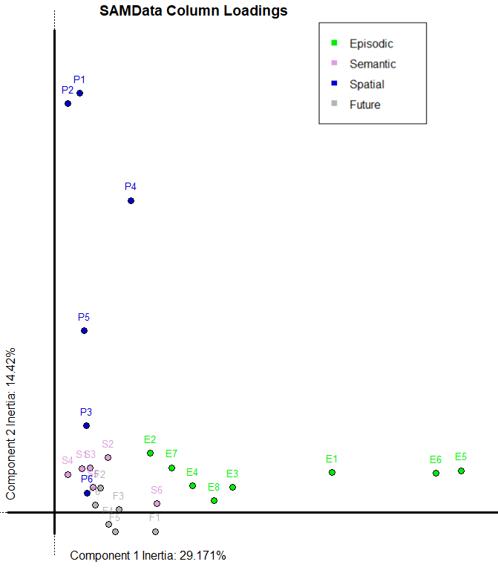
Results (3/5): Loadings (Varimax Rotation)

Slide 7

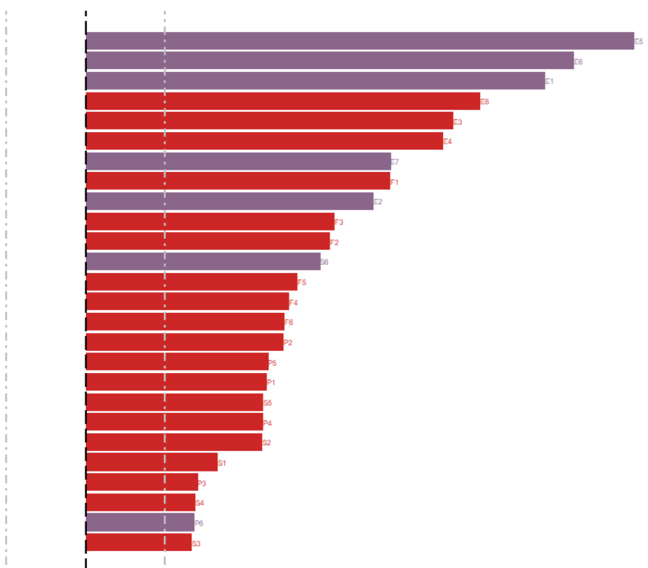
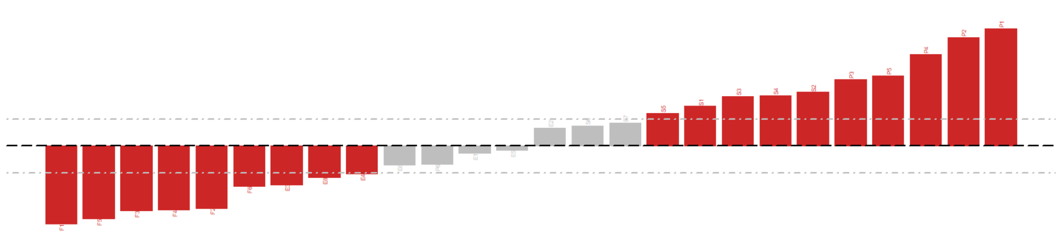
Results (4/5): Bootstrap ratios
Episodic
Spatial
Future

Slide 8
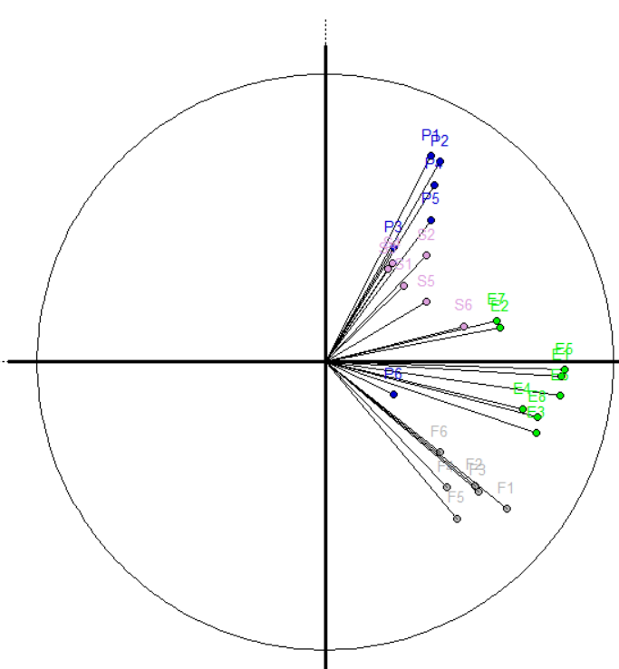
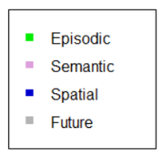
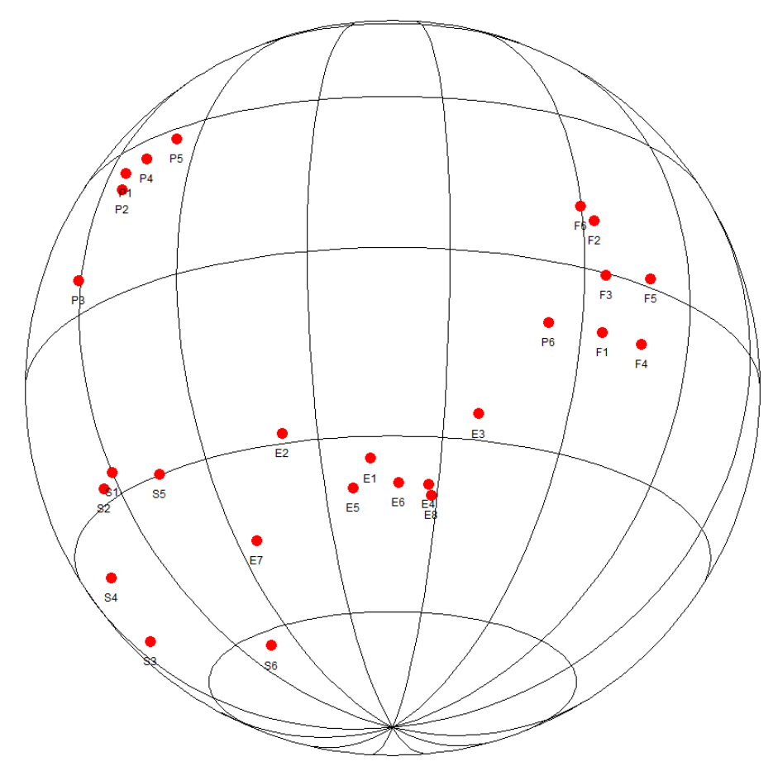
Results (5/5): Correlation circle

Slide 9
Conclusion
Component 1
Row: Normal versus High Memory group
Column: Normal versus High Memory scores
So Component 1 mainly distinguishes people with high versus normal memory group
Component 2
Column: Spatial versus other memory types
Distinguishes questions relating to spatial memory versus other memory types. Also shows negative correlation between spatial and future memory ratings.

Slide 10
Questions or comments?

